Slide 1

Heart Disease Prediction with Machine Learning
Team Members :-
Aviral Vashishtha (RA2211003030186)
Chirag Choken (RA2211003030188)
Bhavya Bharadwaj (RA2211003030188)

Slide 2

Abstract
1
Heart Disease Prevalence
Heart disease remains a leading cause of death globally, underscoring the need for effective preventative measures.
2
Machine Learning Potential
Utilize advanced algorithms for data analysis and feature extraction, improving prediction capabilities and outcomes.
3
Project Goal
Aim to accurately predict heart disease using machine learning, enhancing diagnostics through innovative algorithms
4
Expected Outcomes
The model's performance will be evaluated, and potential applications in clinical settings will be discussed.

Slide 3

Introduction
Heart Disease Overview
Heart disease encompasses a range of conditions affecting the heart, including coronary artery disease, heart failure, and stroke.
Risk Factors
Risk factors for heart disease include genetics, lifestyle choices, and underlying conditions like high blood pressure and cholesterol.
Early Detection
Early detection and intervention are crucial for preventing heart disease complications and improving patient outcomes.

Slide 4
BENEFITS OF MACHINE LEARNING
Machine Learning in Healthcare: Revolutionizes diagnostics, optimizing treatment plans and personalizing patient care based on predictive insights.
Predictive Modeling Advances: Employs algorithms to analyze vast datasets, identifying trends that inform early intervention strategies effectively.
Example Applications: Utilized for early detection of conditions like hypertension and diabetes, improving overall cardiovascular health management.

Slide 5
NEED AND MOTIVATION
Global Rising Incidence: Heart disease cases are surging worldwide, reinforcing the demand for innovative and efficient diagnostic tools.
Timely Interventions Needed: Accelerated diagnosis and prompt treatment are critical to combat escalating heart disease prevalence effectively.
Motivation for Innovation: Rising heart disease rates emphasize the necessity for advanced machine learning technologies in modern healthcare diagnostics.

Slide 6
Existing Problem
Traditional Methods
Data Overload
Missed Opportunities
Traditional heart disease risk assessment relies on manual calculations and clinical judgment, which can be time-consuming and prone to error.
The sheer volume of patient data makes it challenging for healthcare professionals to analyze and interpret risk factors effectively.
Delayed diagnosis can lead to missed opportunities for timely intervention, potentially resulting in more severe complications.

Slide 7

Proposed Solution
Enhanced Prediction Accuracy: Machine learning algorithms analyze complex data patterns, ensuring higher accuracy in heart disease predictions than traditional methods.
Facilitating Earlier Diagnosis: Advanced models identify subtle indicators of heart disease earlier, allowing timely medical interventions to improve outcomes significantly.
Hyperparameter Tuning: Hyperparameter tuning is vital for enhancing a model’s performance. It helps in improving model accuracy, reducing overfitting, and optimizing resource utilization.

Slide 8

Technologies Used
1
Python
3
Matplotlib and Seaborn
Python serves as the programming language for model development and analysis, providing a comprehensive ecosystem of machine learning libraries.
These libraries are used for intermediate level of data visualization.
2
NumPy and Pandas
4
Scikit Learn
Pandas is used for data manipulation and analysis, facilitating data cleaning, feature engineering, and model evaluation.
Scikit-learn provides a wide range of machine learning algorithms, including classification models suited for heart disease prediction.

Slide 9
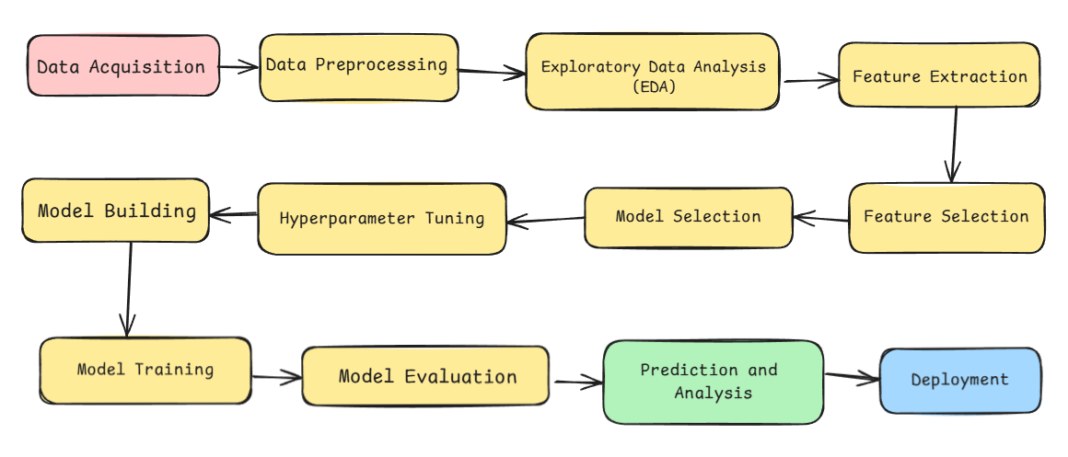
ARCHITECTURAL DIAGRAM

Slide 10
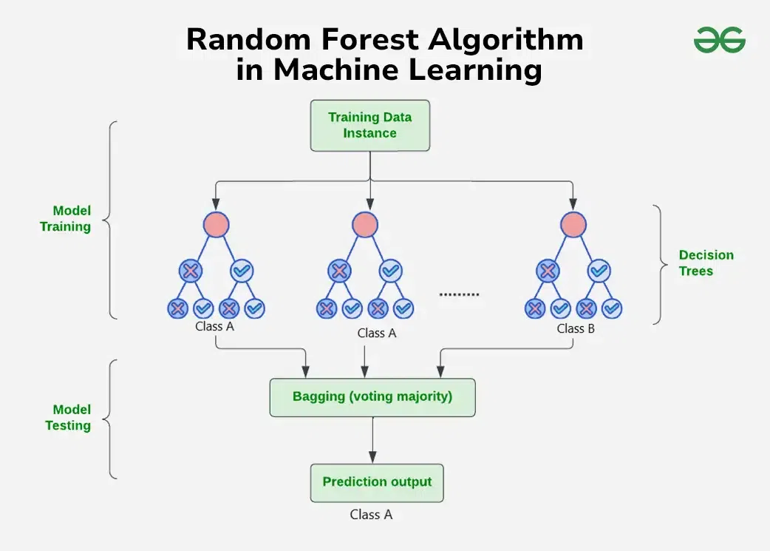
Methodologies
Data Preprocessing: Impute missing data, encode categorical features (such as gender and chest pain type), and standardize numerical values.
Random Forest Algorithm: Random forests consist of multiple decision trees. Each tree is trained on a random subset of the data, and the final prediction is an aggregate (e.g., majority vote) of all trees.
Model Evaluation: Use cross-validation and a confusion matrix to assess the model’s performance.
Hyperparameter Tuning: Adjust parameters like the number of trees, max depth, and feature set to optimize model performance.
Logistic Regression: In this case, we trained a logistic regression model to estimate the probability of a patient developing heart disease.

Slide 11
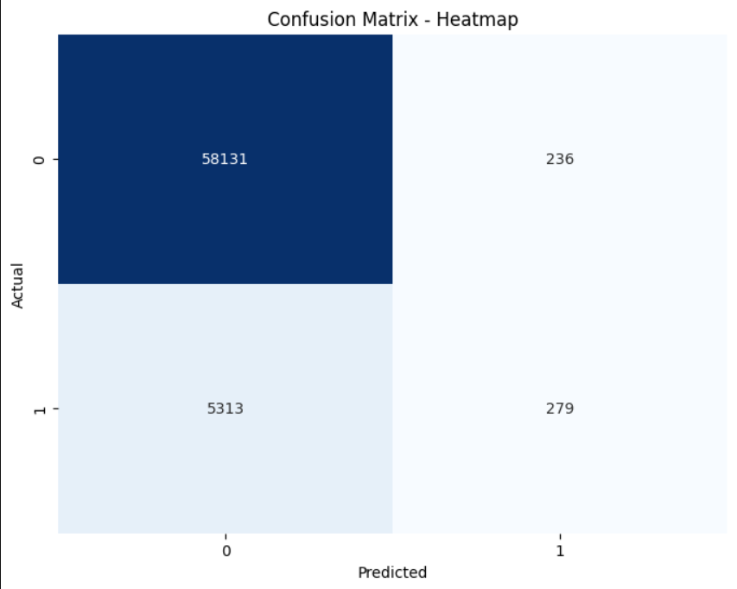
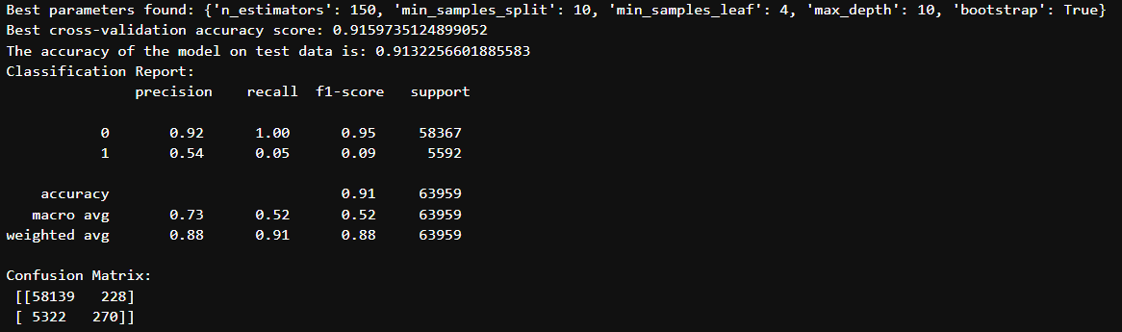
Results
Model Evaluation
The trained models were evaluated using various metrics, including accuracy, precision, recall, and F1-score.

Slide 12


Conclusions
1
Model Accuracy
The developed machine learning model achieved a high level of accuracy in predicting heart disease risk, demonstrating its potential for clinical applications.
2
Early Detection Potential
This model has the potential to aid healthcare professionals in identifying individuals at higher risk of developing heart disease, enabling early interventions and improving patient outcomes.
3
Usage of Random Forest Algorithm
The random forest model effectively predicts heart disease with high accuracy and balanced performance on precision and recall. It leverages the benefits of ensemble learning, which reduces overfitting and increases robustness.

